Slide 1
Dynamic Programming-2
Lecture-7: Introduction & Discrete Knapsack Problem
Md. Golam Shahriar,
Lecturer, Dept. of CSE, VU

Slide 2
The 0/1 Knapsack Problem
Unlike the fractional knapsack problem, where we were allowed to take a fraction(or whole) of any item to fill our knapsack in order to maximize our total profit, in the discrete or 0/1 knapsack problem, whether we can chose to take a particular item as a whole or leave it out altogether.
We employed a greedy design technique in the case of fractional knapsack and that gave us an optimal solution.
But not in this case particular case.

Slide 3
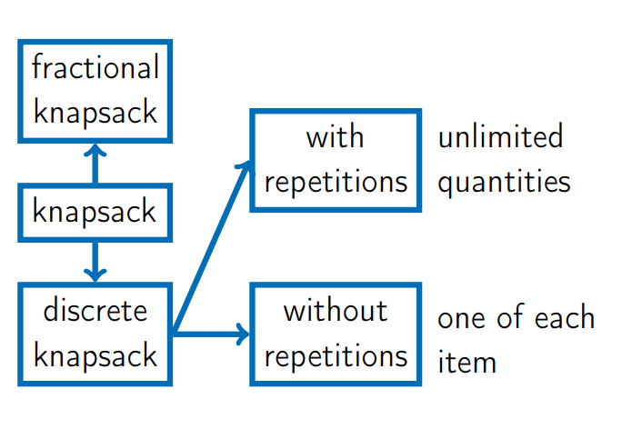
The Knapsack Problem Variations

Slide 4
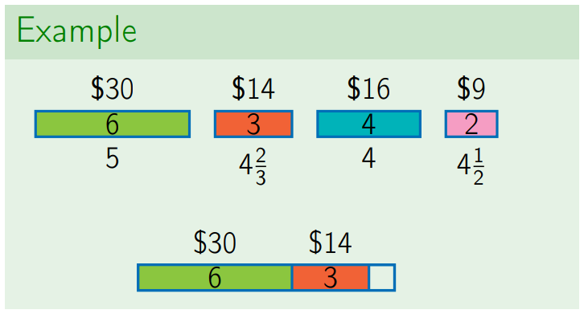
Greedy Fails for Discrete Knapsack Case

Slide 5
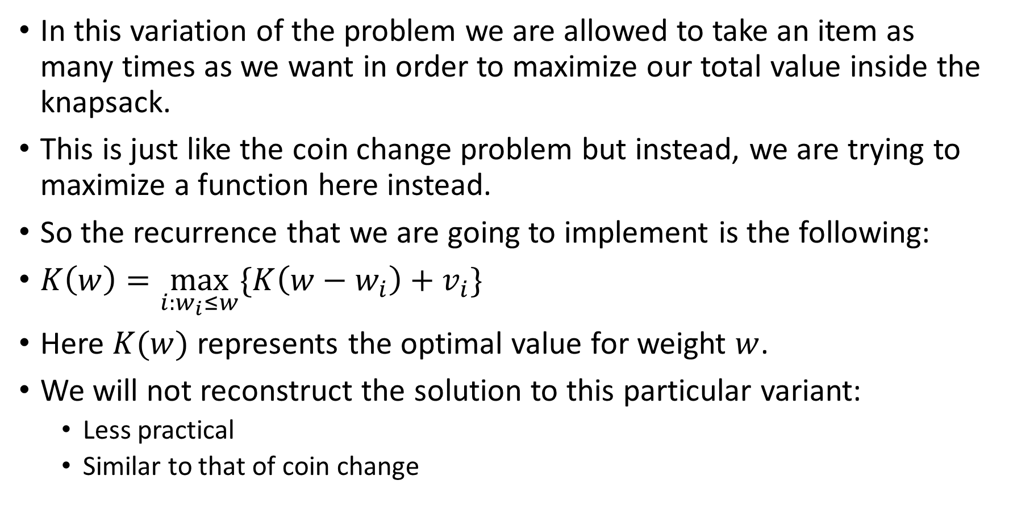
0/1 Knapsack With Repetition

Slide 6
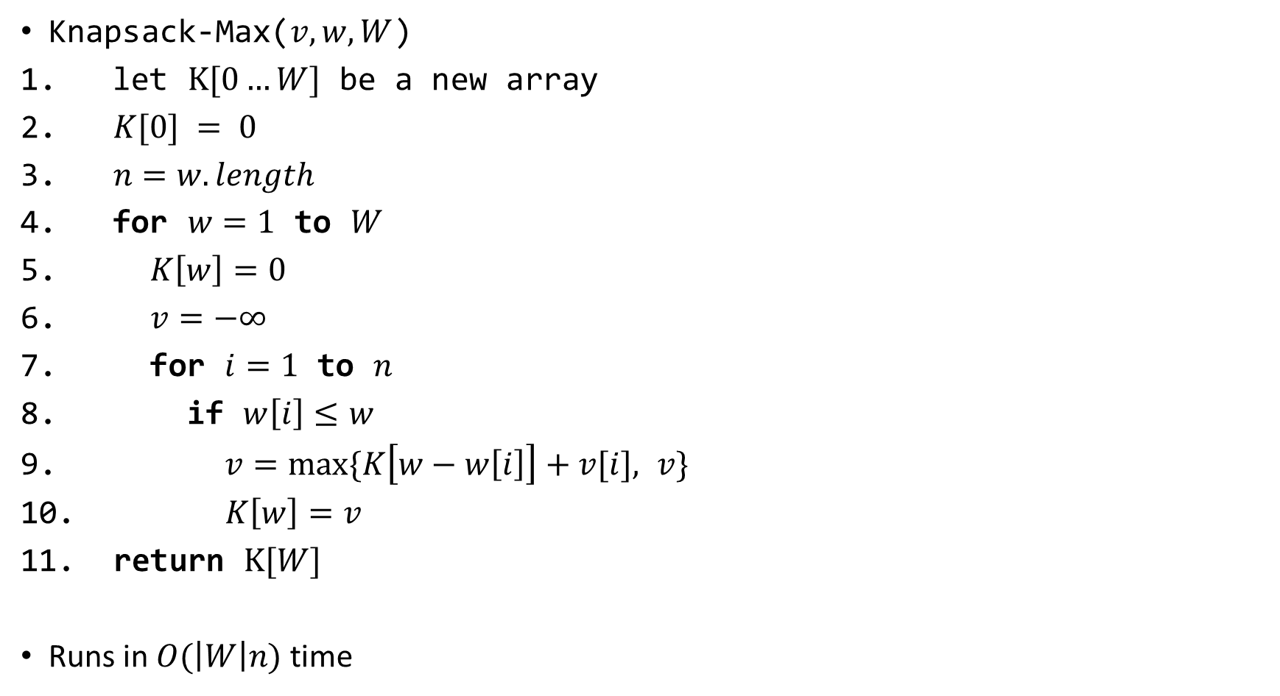
The Algorithm

Slide 7
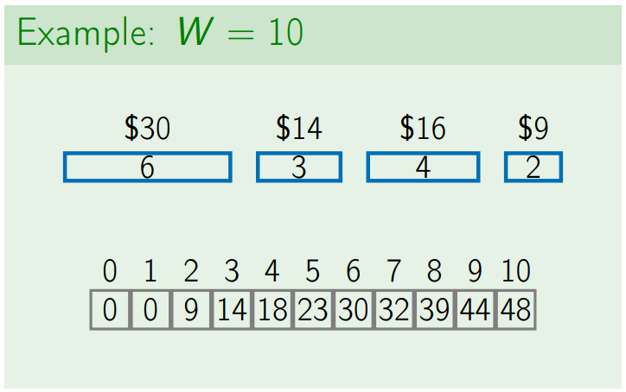

Slide 8
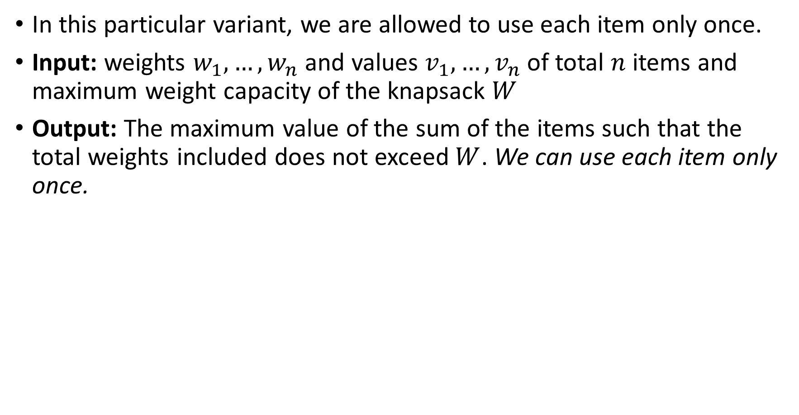
Knapsack Without Repetition

Slide 9
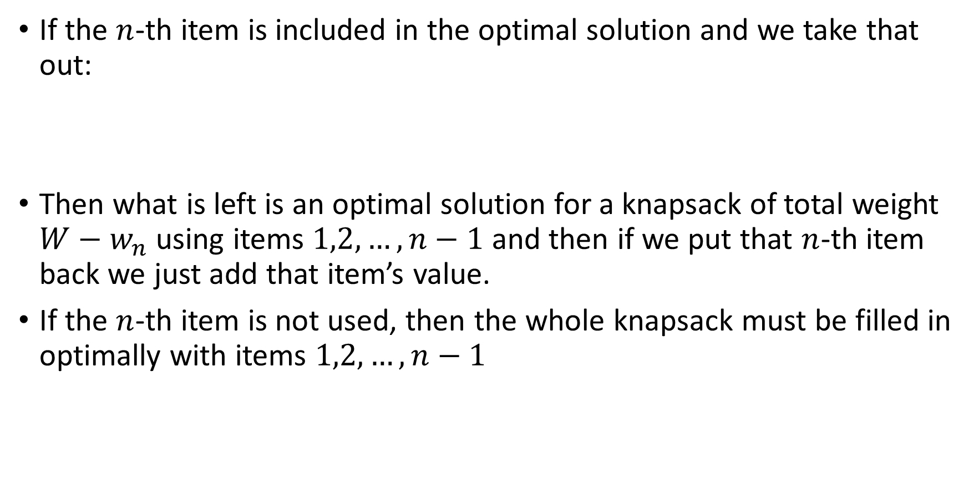

Subproblems

Slide 10
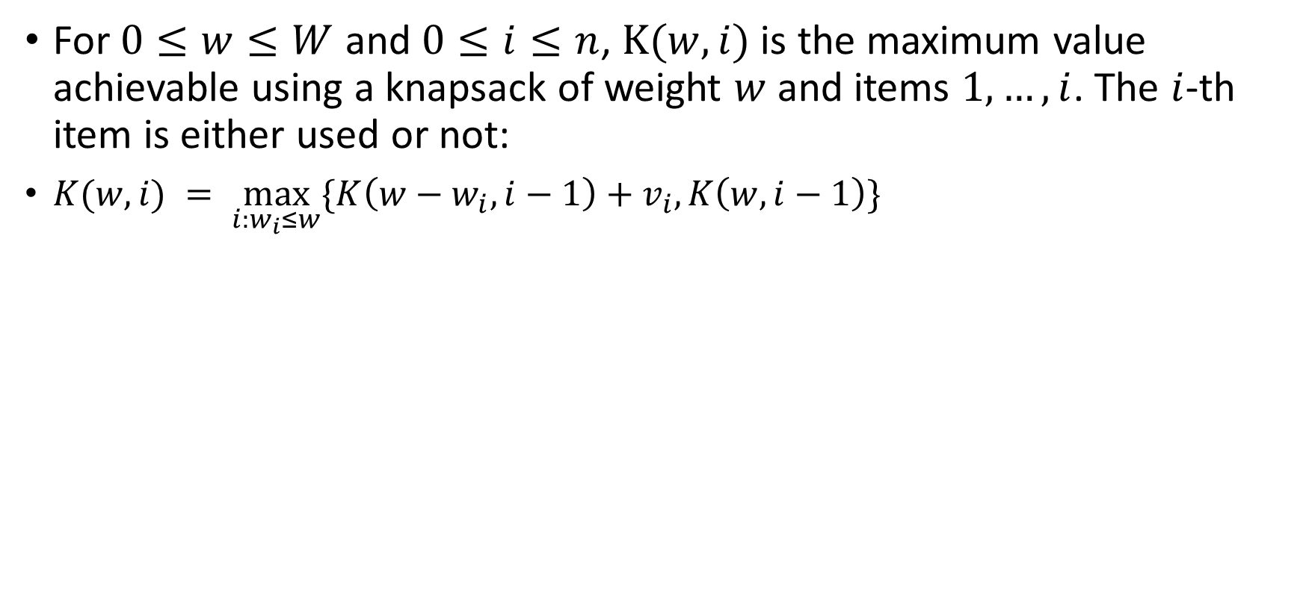
Subproblems (continued)

Slide 11
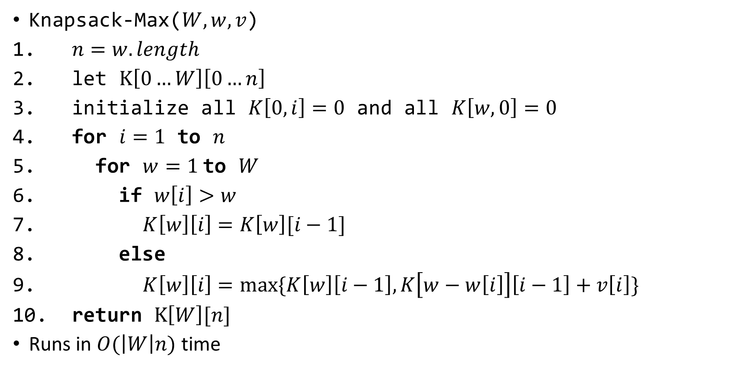
The Algorithm

Slide 12
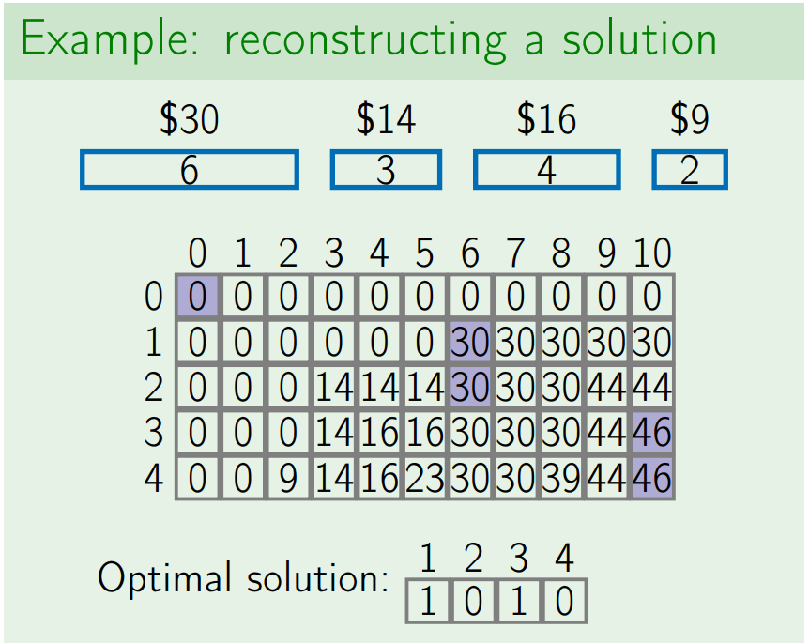

Slide 13
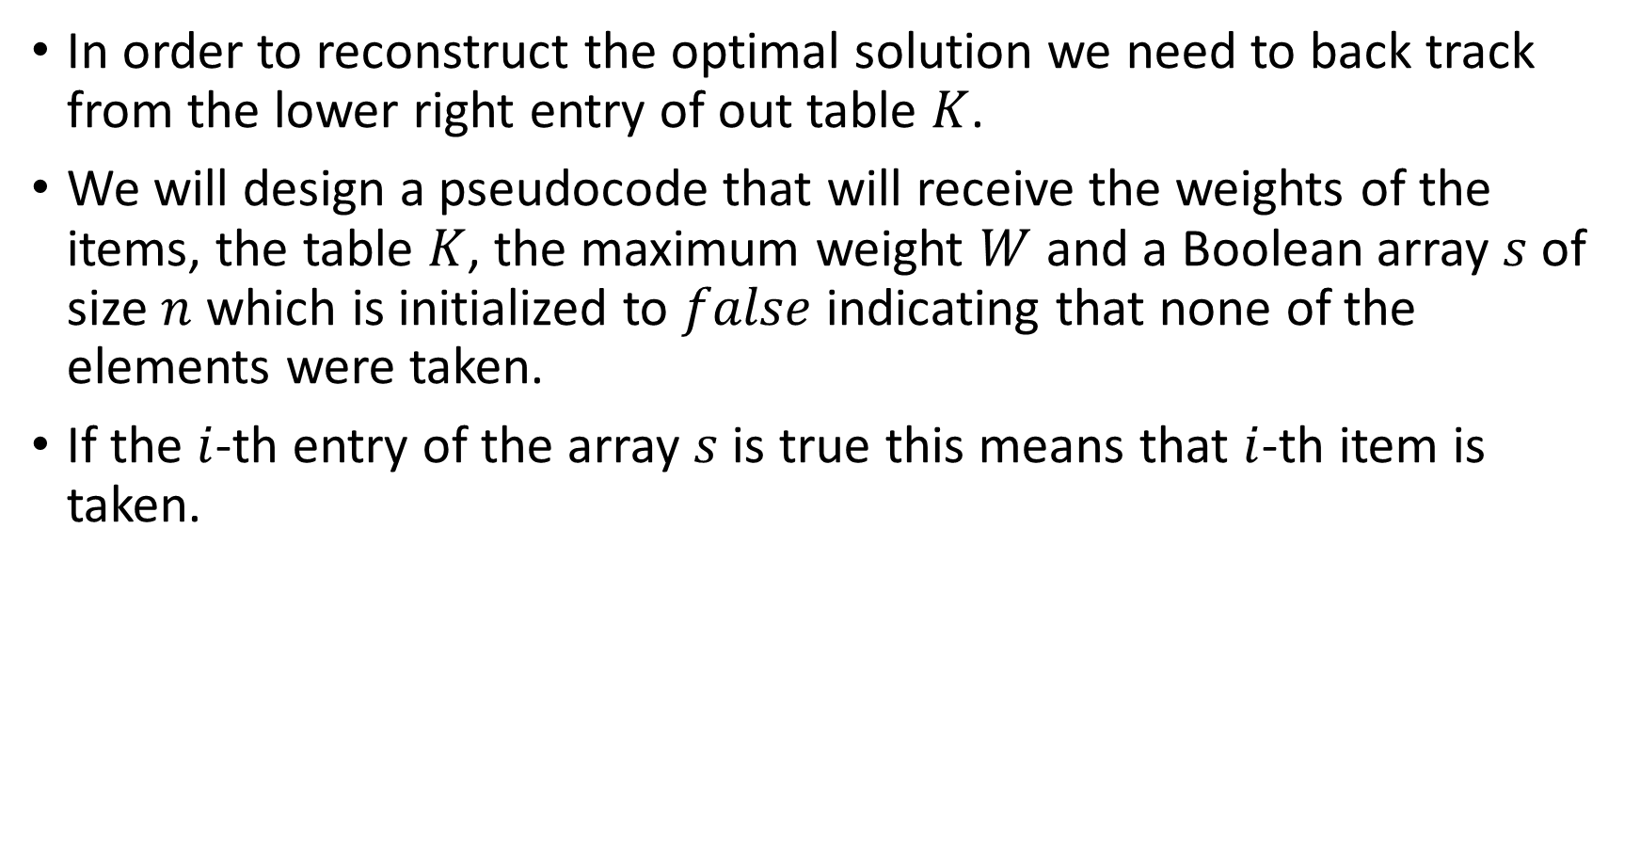
Reconstructing The Optimal Solution

Slide 14
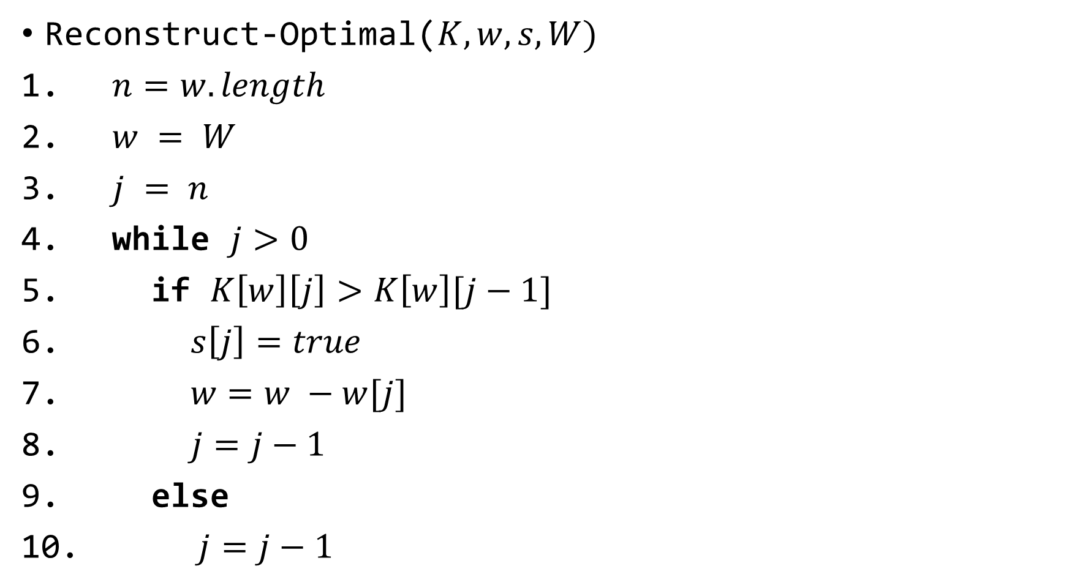
Reconstructing The Optimal Solution

